Slide 1


Capstone Project-ML Foundation Course
Ishani Udeshika

Slide 2


Objective
Develop an anomaly detection model capable of accurately distinguishing abnormal patterns or outliers in the machine temperature dataset.

Slide 3




Introduction
Identifying outliers in the machine temperature failures.
Patterns recognition
Temperature Failures
Time series analysis

Slide 4




Data Overview
Data Sources
Converted timestamps to datetime format and extracting temporal features (year, month, day, hour, minute)
Predictive Model

Slide 5
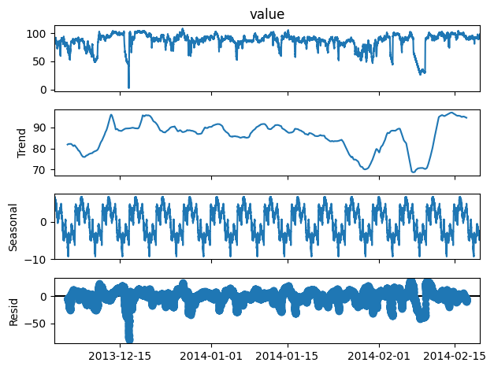
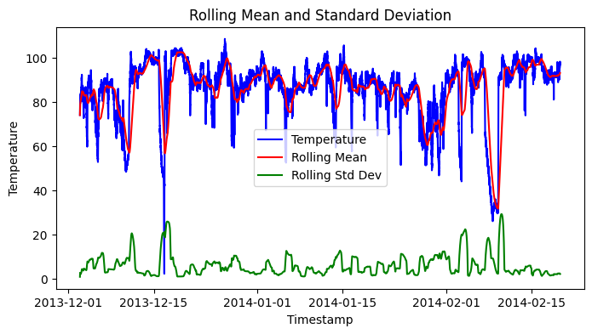
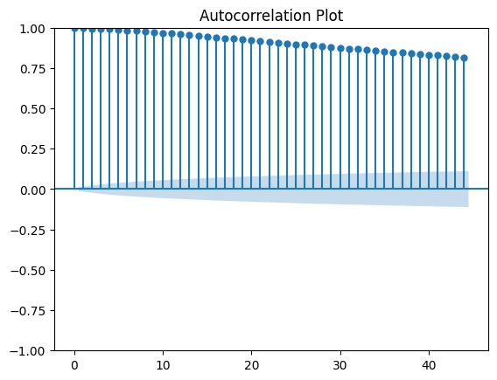
EDA
Statistical Analysis
Seasonal decomposition
Rolling Statistics
Autocorrelation & Partial Autocorrelation
Hourly Distribution

Slide 6
Model Selection
Model Evaluation
Try to build the model using below methods in Unsupervised way.
1. Standard Deviation Method
2. One-Class SVM (Support Vector Machines)
3. Isolation Forest
4. Variance Based Method
 | Standard Deviation Method | One-Class SVM (Support Vector Machines) | Isolation Forest | Variance Based Method
F1 Score | 0.544078 | 0.422444 | 0.527986 | 0.585277

Slide 7
Conclusion
* The model built with simple algorithms resulted in high accuracy.
* It is considered that a simple algorithm is effective in many cases for time-series data having a simple structure such as a constant mean and variance over time.
* Complex and robust algorithms are considered to be effective when time-series has complicated patterns or when there are various anomolous patterns.
* In this analysis, the model was evaluated based on the F1 score, but if you want to make a more business-oriented evaluation, the following viewpoints should be added to the evaluation.
* Detection of signs of anomalies
* Balance of importance of false positive and false negative
Model interpretability

Slide 8
Thank You !

